Slide 1
EasyPark
Jaya Surya Garapati
Vasanthi Lingamdinne

Slide 2
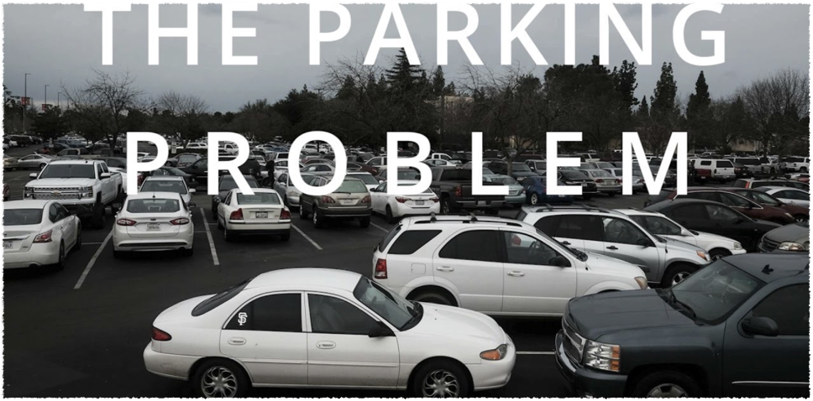
Parking Problem
At CSUCI

Slide 3
“In one year, Americans travel up to 950000 miles , Waste 47000 gallons of gas and release 730 tons of green house emissions while looking for parking.”

Slide 4

The current system in place at CSUCI is, there are certain number of parking slots available throughout the campus at various locations.
Anyone with a permit vis-a-vis Daily and Semester, can park their vehicle anywhere among the locations provided they can find a spot.
This system, if we are being polite, is not efficient in terms of time taken to find a spot, We generally do not have a track of number of spots available at any given point of time.

Slide 5
EasyPark
It is developed keeping in mind the amount of time being wasted, and we try to lessen the amount of time searching for parking spots.
Traveling has become a integral part of our life, along with it parking.

Slide 6
Personas

Slide 7
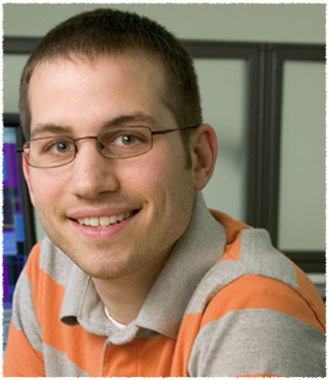
Robert Smith
Lives in Camarillo
Computer Science Graduate student at CSUCI
Holder of a term permit.
Thinks that the current system is not efficient and can do a lot better.
Likes to spend a lot less time than what is the norm right now looking for parking.
Life is short and sweet, why waste it looking for parking.

Slide 8

Jean Grey
Lives in Thousand Oaks.
Undergraduate Student pursuing psychology.
Regularly gets a daily permit.
Feels that the current system can do a lot better.
“ I am okay with a delay of 15 minutes, while looking for parking but when put cumulatively on a larger note, they kind of are giving me a head ache”.

Slide 9
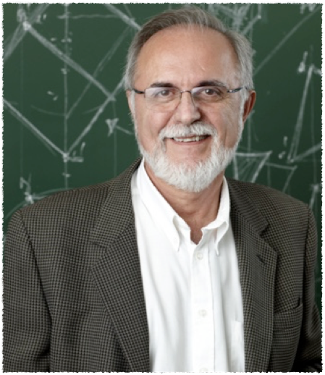
James Johnson
Lives in Ventura.
Professor at CSUCI
Has to attend the campus daily.
Thinks about the good old days and how they are perfect because of less pollution and less complications.
Would like to spend less time searching for a parking spot everyday.
“Pain and Confusion are an integral part of the life but it is better not to have them”.

Slide 10
Use Cases

Slide 11
Use Case Scenario
Edward Baskerville comes to the college and looks for a parking spot. He uses the EasyPark App and purchases the daily permit based on the availability of slots at his desired location.
If he wants to get a spot at Bell Tower and he finds parking full over there, He can always check into a different location and repeat the process until he finds a spot of his own choice.

Slide 12
Design Principles

Slide 13
Accessibility
We have designed the app in a way such that it is easy to access all the content and pretty much easy to use in general.

Slide 14
Affordance
All the details to be selected are given in small sequential screens, assuring affordance. Anyone can use the app at any given time without any issue.

Slide 15
Working Principle

Slide 16
We have compartmentalized the slots into four different classes based on their location, namely :
Sage Hall
El Dorado Hall
Library
Bell Tower

Slide 17
We have categorized the parking slots into three different classes, namely :
Daily Permit Slots
Term Permit Slots
Faculty Slots

Slide 18
Each class is to be given a certain number of allocations based on the requirement
For now, we allocated 40% of the slots to daily permits, 50% of the slots to term permits and 10% to faculty.
As there are multiple locations where a person could park , the number of slots could vary but the ratio is to be the same throughout.

Slide 19
EasyPark - Demo

Slide 20
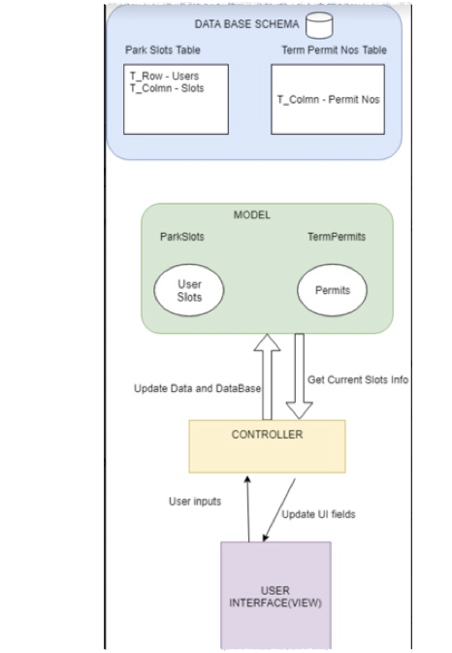
System Architecture Design

Slide 21
Future of EasyPark
We plan to develop the app in away such that it has real time GPS tracking with mechanism which is aimed to track the movement of the vehicles without any human intervention, with the help of IOT(Internet of Things).
We plan to add several functionalities to the prototype to make it a fully functioning app which can be used by the masses.

Slide 22

Queries

Slide 23
Thank You

